Slide 1


Music Store Database Project
(SQL Database Design, Queries, and Insights)
Your Name: Mennuli Prasad, MCA

Slide 2
Introduction
A Music Store database is designed to manage:
Employees
Customers
Artists & Albums
Tracks
Invoices & invoiceline
Playlists
Goal: Analyze business insights like best customers, top artists, and
popular genres.

Slide 3

ER Diagram
Relationships:
Customer ↔ Invoice
Invoice ↔ Invoice-Line ↔ Track
Artist ↔ Album ↔ Track
Track ↔ Genre
Employee (self-referencing manager)
Entities:
Employee
Customer
Artist → Album → Track
Genre
Invoice → Invoice Line
Playlist

Slide 4
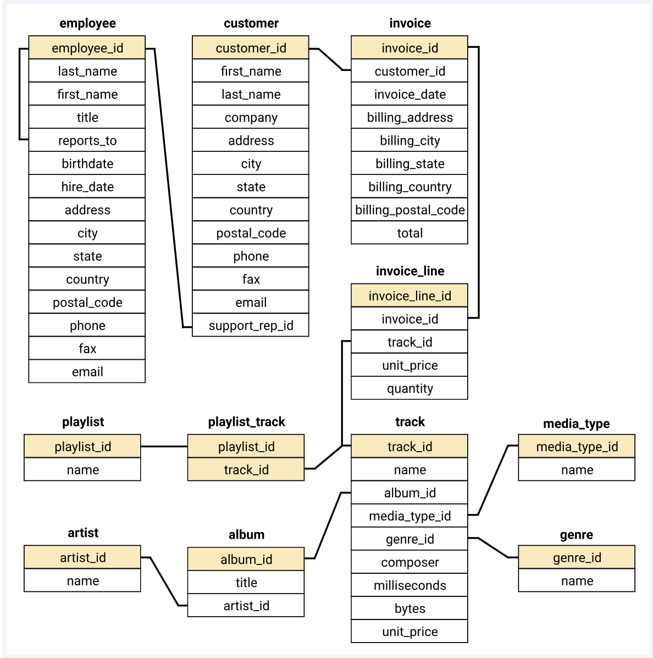

Slide 5


Database Schema
Employee: Stores staff details
Customer: Customer details & location
Artist & Album: Music creators
Track: Song details (price, duration)
Genre: Music categories
Invoice & Invoice-Line: Purchases & sales
Playlist: Custom track lists

Slide 6
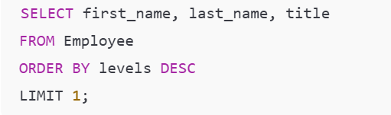
1.Senior-most Employee -> Finds the highest-level employee .

Slide 7

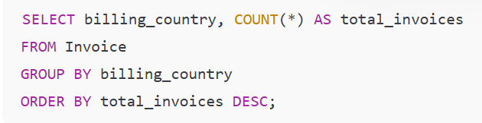
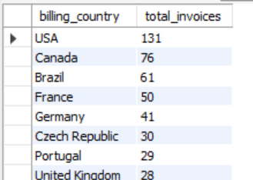
2.Countries with Most Invoices -> Shows countries with highest invoices.

Slide 8

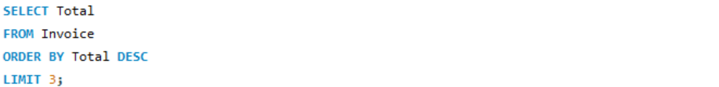
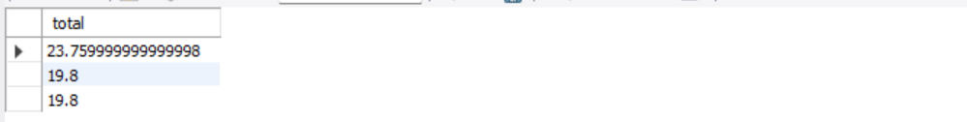
3.Top 3 Invoice Totals
Finds biggest purchases made by customers.

Slide 9
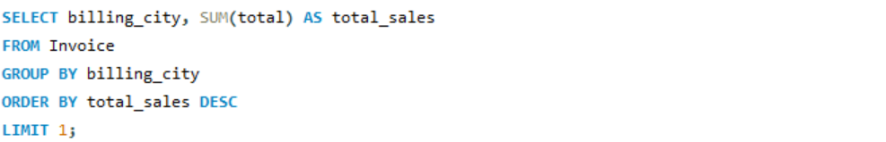

4.City With Best Customers
Identifiers city with highest sale revenue

Slide 10
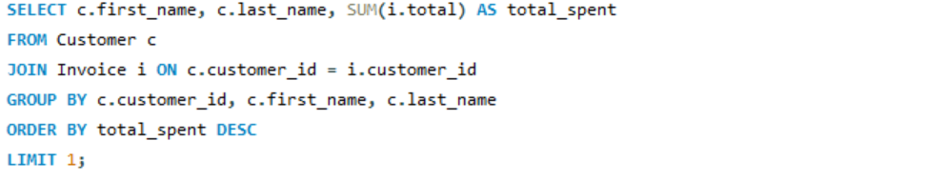
5.Best Customers
Find top spending customer.

Slide 11
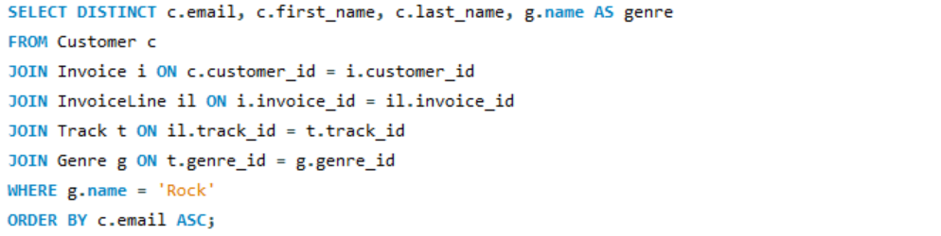

6.Rock Music Listener
Who listen to Rock Music.

Slide 12

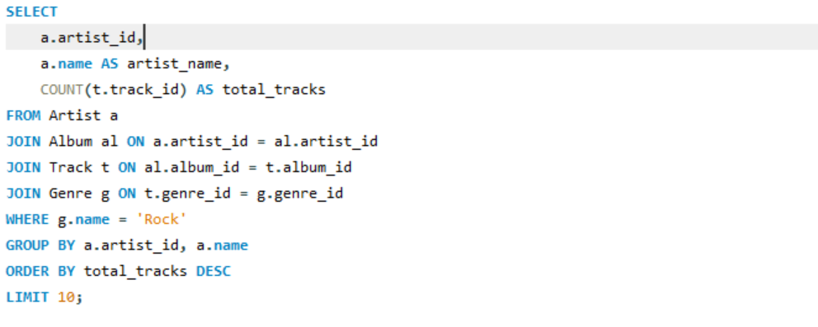

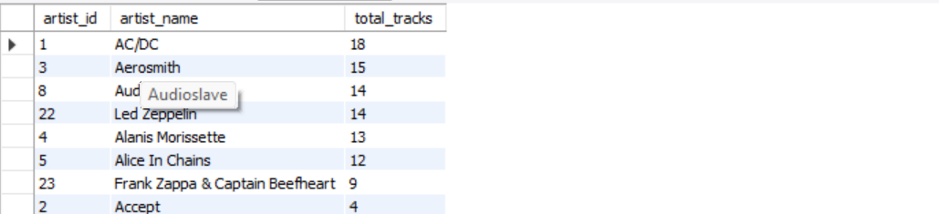
7.Top 10 rock artists
Artists with most Rock Tracks.

Slide 13


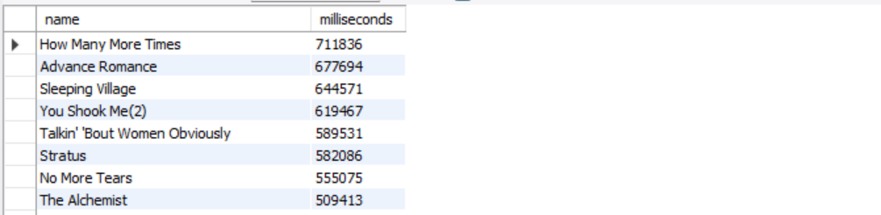
8.Tracks Longer than Average Finds all tracks that are longer than the average duration of tracks in the database.

Slide 14
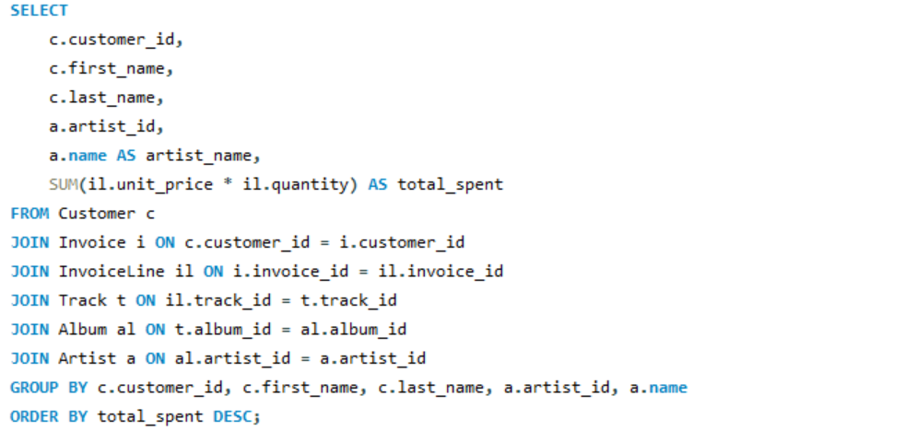
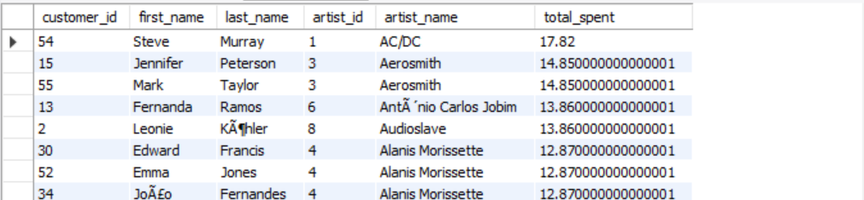

9.Amount Spent by Each customer on Each Artist
Finds how much money each customer has spent on songs/albums of each artist.

Slide 15
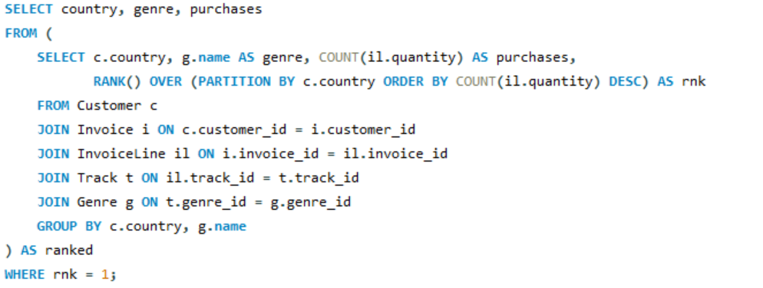
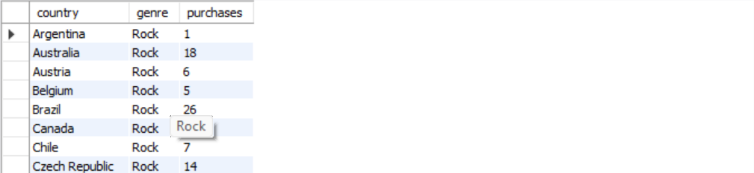
10. Popular Genre per Country
This query shows the top genre in each country, and Rock is the most popular.

Slide 16
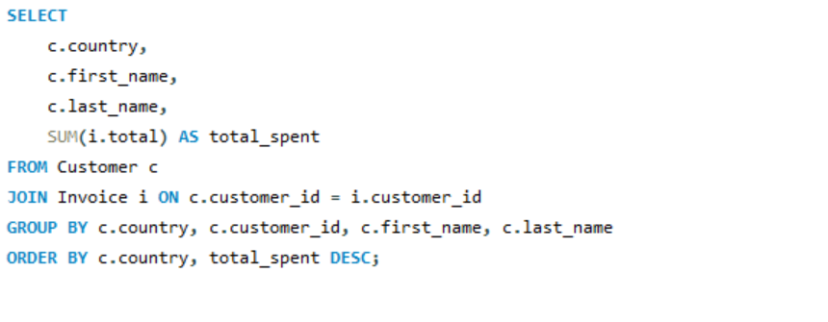

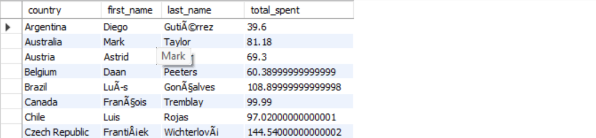
Top Customer per Country
This query shows the top-spending customer in each country.

Slide 17

Conclusion
Designed a relational music store database with proper schema and ER diagram.
Wrote SQL queries to analyze business data.
Identified senior-most employee, top customers, popular cities & countries.
Found top genres, leading artists, and customer preferences.
Queries revealed spending patterns of customers across artists.
Insights help in marketing strategies and sales growth.

Slide 18



